Slide 1
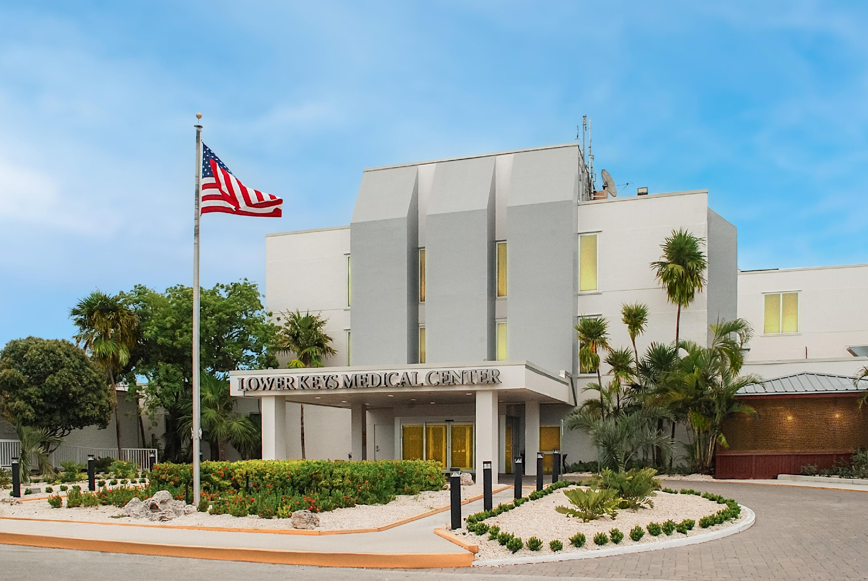

Lower Keys Medical Center
November 2025

Slide 2
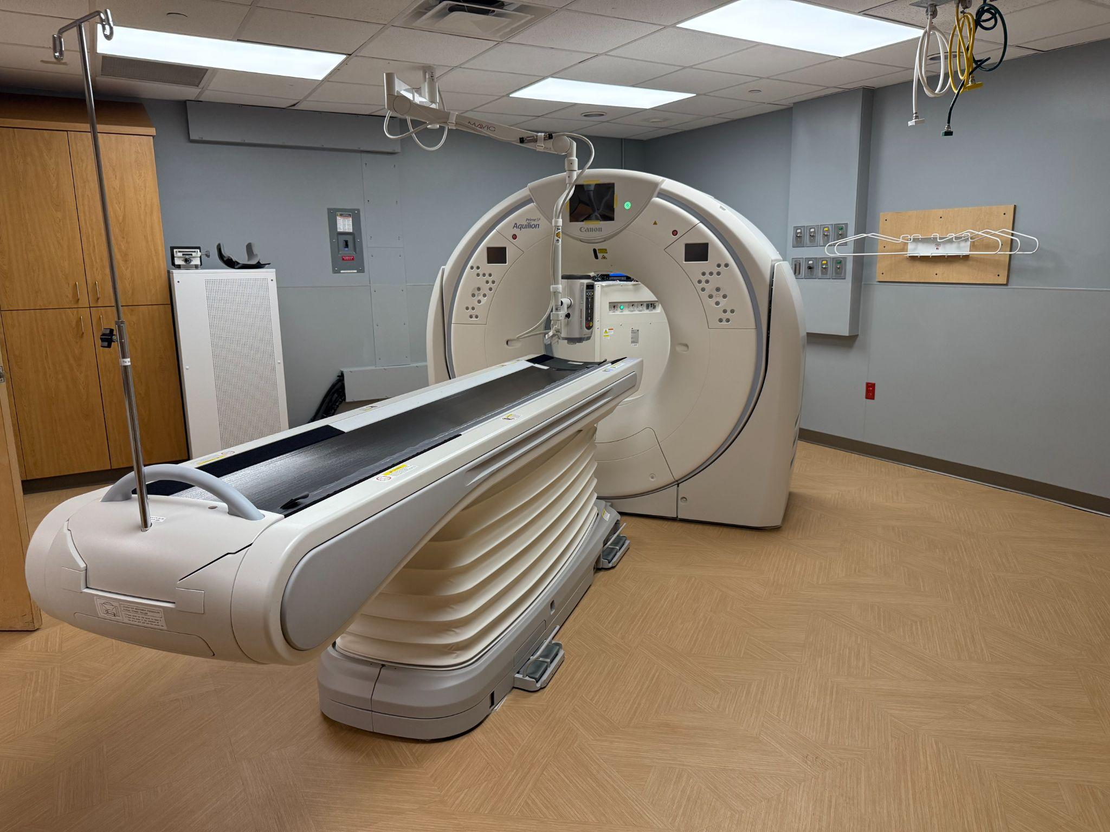
Equipment and Facility Investments
CT Upgrade
  New equipment, room refresh
  Training November 10
  Faster scan times
  Iimproved quality
  Enhanced cardiovascular testing
Renovated surgical lobby
Room Renovations
  First wave complete by mid-November
  Phase 1 renovations complete by EOY
  Phase 2 to continue in 2026
Facility Upgrades
  Stairwell maintenance
  Air handler units
  Landscaping/exterior painting

Slide 3
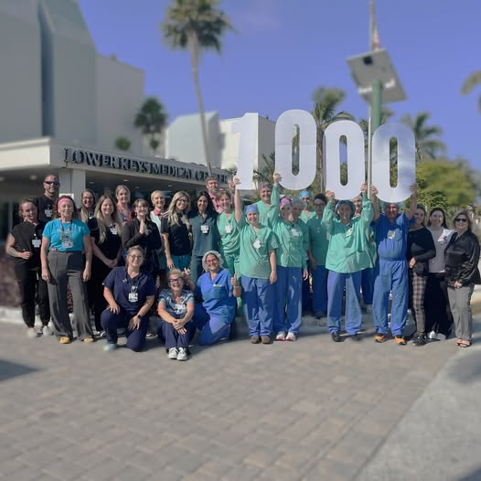
Quality
CMS 4-Star Rating
  Above average
  Quality, Safety, Patient Experience
AHA Get With The Guidelines Stroke Gold Plus
Accreditations/Certifications
  Joint Commission Primary Stroke Center
  ACC Chest Pain Center Accreditation
  Joint Commission Hospital Accreditation
  Full accreditation with no conditional findings
More than 3 years without a Serious Safety Event

Slide 4
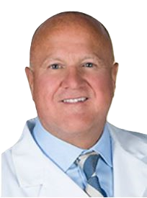

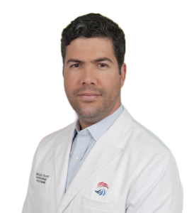


2025 Provider Recruitment
Keys Medical Group Recruitment
      Grace Maliberan, APRN, Gastroenterology
      Aldo Beretta, M.D., Orthopedics
      Edgardo Montemayor, M.D., Family Medicine
      Leandro Perez, M.D., Interventional Cardiology
      Julian Javier, M.D., Interventional Cardiology
Grace Maliberan
Dr. Aldo Beretta
Dr. Edgardo Montemayor
Dr. Leandro Perez
Dr. Julian Javier

Slide 5
Transfer Data, July-October
Continue to Keep Care in the Keys with fewer than 5% of patients requiring transfer
Primary reasons – trauma, neurology services, cardiac care, behavioral health,, pediatrics
Month | % Transfers
July | 4.7
August | 3.9
September | 4.6
October | 4.7

Slide 6
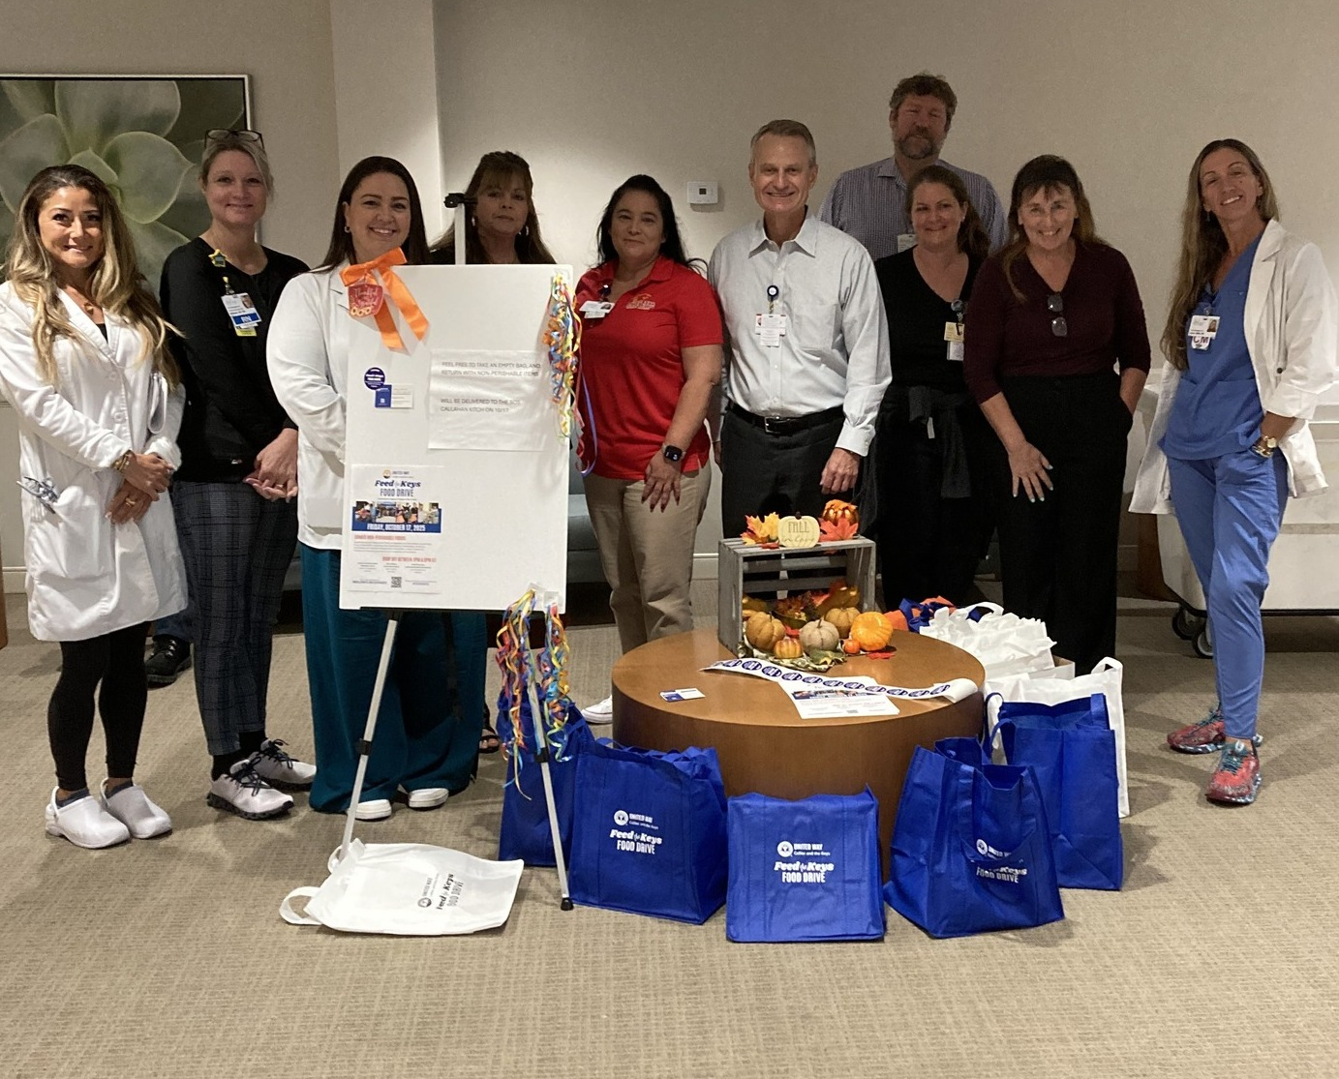
Community Involvement
$100,000 donation to the College of the Florida Keys
Lower Keys Medical Center scholarship for high school seniors
Sponsorships and donations
  Doctors’ Day donations to MARC House, Habitat for Humanity, Samuels House
  Community Foundation Unsung Heroes
  Wesley House
  Key West Woman’s Club
  WomanKind
  Take Stock in Children
  Community Health of South Florida
  Guidance Care Center
  Cancer Foundation of the Florida Keys
  Keys Healthy Start
  Local Youth sports
Employee and Community Events
  United Way Feed the Keys food drive
  CHI/Florida Health World Diabetes Day event
  Annual Holiday Parade

